Slide 1
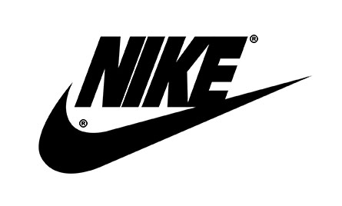
INVENTION OF NIKE HYPERADAPT 1.0
Name
Institution affiliation

Slide 2
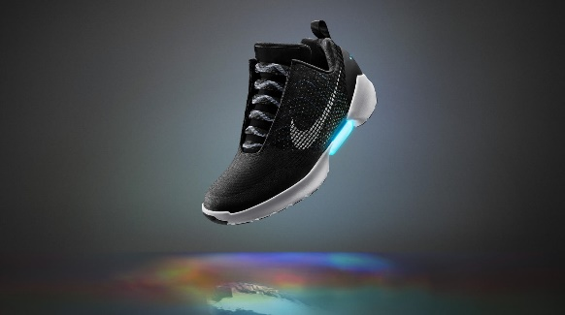
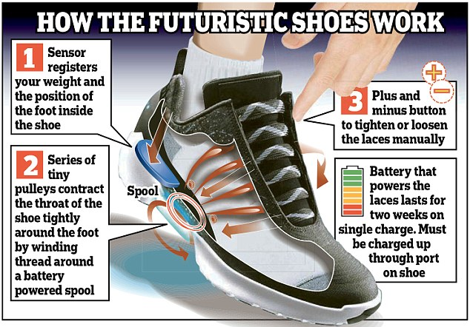
DESCRIPTION OF NIKE HYPERADAPT 1.0
It is the first fully-functioning athletic shoe that electronically adjusts to the contours of an athletes foot through adaptive lacing technology (HyperAdapt, 2016).
It provides a customized fit depending on what the user wants, making users feel like it is an extension of their body.
It has two buttons on the side that tightens and loosens it to enable achieve a perfect fit (HyperAdapt, 2016).
Best suited for a person with idiosyncrasies during racing and tension preference reduction product.
Basically, the shoe diminishes
an athletes distraction.

Slide 3
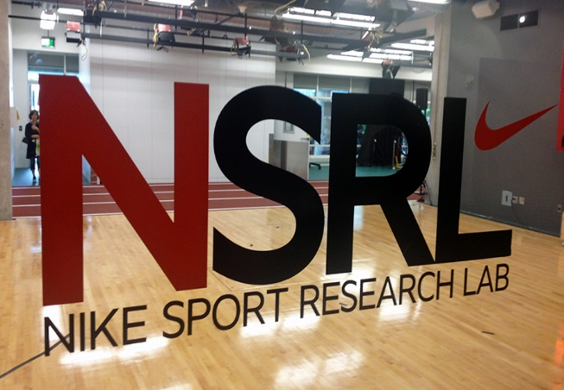
IMPORTANCE OF R&D TO LEAD USERS AND MARKET RESEARCH
It gives Nike the competitive advantage over its competitors in that they produce what the market demands because of the R&D.
The R&D enables them to differentiate their products from the others in the industry, due to the huge influx of knowledge about the market.
Most of its users are athletes, and the company has a role to play in incorporating them in developing innovation for the company to realize growth (HyperAdapt, 2016).
The company must work to guard its innovation against competitors as ideas invention is the most critical part in the development of any company. Any other company can take advantage of such invention and may end up implementing such idea.

Slide 4
APPROPRIATE STRUCTURES AND CULTURE TO SUPPORT INNOVATIVE IDEAS
Nike’s culture is centered on creativity and innovation to provide products like HyperAdapt 1.0, which suit current consumer preference (HyperAdapt, 2016). The structures support advancements of new ideas.
Nike understands that innovation and culture goes hand in hand. They provide HR support like training, coaching and mentoring programs for product development (HyperAdapt, 2016).
Their culture promotes diversity leading to a dynamic workforce, hence promoting creativity, innovation and brand image.
Their structures and culture encourages inclusivity, minimizing barriers to employee performance, hence optimizing performance, employees development and increased creativity.
It has structural approaches based strategies that ensure timely development and production of new product to the market (HyperAdapt, 2016).
The company has invested in R&D to get innovative ideas and embraces innovation and technology in product development.

Slide 5
ANALYSIS OF FUTURE INNOVATIONS OF HYPERADAPT 1.0
Despite being the first innovation of its kind in the industry, it still has room for improvement and innovations. The product can be further innovated to improve on how it works as discussed below.
Kicks are not fully automated and the user uses two buttons near the top lace loop to adjust tightness (Hatfield & Beers, 2017). Improvement in that can be great.
Nike is also still looking for ways of improving its Electro Adaptive Reacting Lacing so that it can adapt to the users foot in real time (Hatfield & Beers, 2017). If achieved, that would be a revolution for footwear.
It played a significant improvement in athletic lacing competition with massive improvement on racing record; however, the price is high and that is attributed to manufacturing cost, the future innovation should focus on reduction of cost of production while maintaining or improving quality resulting to reduced pricing in the market (Hatfield & Beers, 2017).
It should focus on improving the product to cater for other sporting fields so as to ensure growth.
This was however a successful invention leading to innovation.

Slide 6
PREDICTION OF PRODUCT DEMAND IN FIVE YEARS
In five years the product demand is expected to have increased because of the company’s culture in investing in R&D and improving its products (Clarke et al., 2016). The product will be further improved depending on market needs leading to increased demand.
The quality of this product and its unique features also guarantees increased demand and sales in five years (Clarke et al., 2016). Marketing to increase the products awareness will increase its demand.
The demand is also likely to increase when the product will have been well known by athletes and sports firms around the world (Clarke et al., 2016). Its quality will increase demand.

Slide 7

REFERENCES
Clarke, M. E., Dunne, L. E., & Holschuh, B. T. (2016). Self- adjusting wearables: variable control through a shape-memory latching mechanism. In Proceedings of the 2016 ACM International Joint Conference on Pervasive and Ubiquitous Computing: Adjunct (pp. 452-457). ACM.
Hatfield, T. L., & Beers, T. A. (2017). U.S. Patent No. D801,023. Washington, DC: U.S. Patent and Trademark Office.
HyperAdapt, N. (2016). 1.0 Manifests the Unimaginable. News. Nike. Com.

